Slide 1
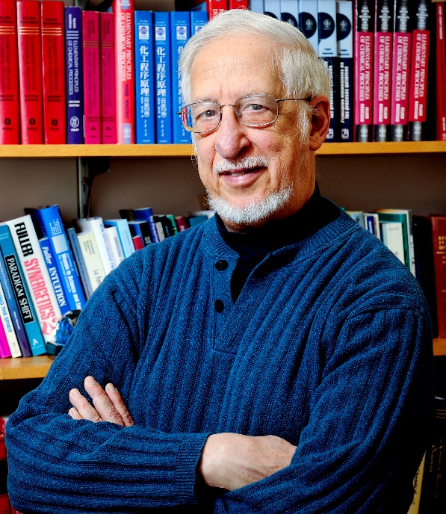
4-5: A test checklist, video by Barbara Oakley, PhD, featuring the “Test checklist” of Richard Felder, PhD

Slide 2
Test Preparation Checklist, by Richard Felder, PhD.
The answer to the question “How should I prepare for the test? Is -- Do whatever it takes to be able to answer “Yes” (meaning “usually”) to most of the questions on this list.
1. Did you make a serious effort to understand the text? (Just hunting for relevant worked-out examples doesn’t count.)
2. Did you work with classmates on homework problems, or at least check your solutions with others?
3. Did you attempt to outline every homework problem solution before working with classmates?
4. Did you participate actively in homework group discussions (contributing ideas, asking questions)?
5. Did you consult with the instructor or teaching assistants when you were having trouble with something?
6. Did you understand ALL of your homework problem solutions when they were handed in?
7. Did you ask in class for explanations of homework problem solutions that weren’t clear to you?
8. If you had a study guide, did you carefully go through it before the test and convince yourself that you could do everything on it?
9. Did you attempt to outline lots of problem solutions quickly, without spending time on the algebra and calculations?
10. Did you go over the study guide and problems with classmates and quiz one another?
11. If there was a review session before the test, did you attend it and ask questions about anything you weren’t sure about?
12. Did you get a reasonable night’s sleep before the test? (If your answer is no, your answers to 1–11 may not matter.)
Yes No TOTAL

Slide 3
Credits
Richard M. Felder, courtesy Richard M. Felder.
Checklist courtesy Chemical Engineering Education and Richard Felder; Felder, Richard M. "Memo to Students Who Have Been Disappointed with Their Test Grades." Chemical Engineering Education 33, no. 2 (1999): 136-37.
Relevant Readings
Felder, Richard M. "Memo to Students Who Have Been Disappointed with Their Test Grades." Chemical Engineering Education 33, no. 2 (1999): 136-37.

